Slide 1
MINES-VIS
Week 2

Slide 2
TOPICS in brief week 2
Topics Image Processing:
Filtering (smoothing, blurring, features)
More about Image filtering inOpenCV.
Connectivity regions, boundaries
Image morphology
Arithmetic, set and logical operations, additional information

Slide 3
Image Processing
Smoothing, filtering
Filtering is a technique for modifying or enhancing an image. For example, you can filter an image to emphasize certain features or remove other features.
To reduce noise or camera artifacts.
To reduce resolutions.
To detect edges, corners etc.

Slide 4
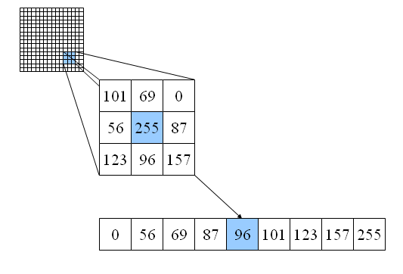
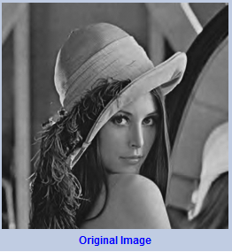
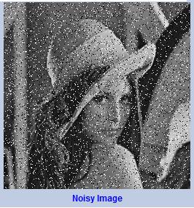
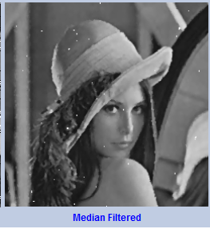
Image Processing(recap)
smoothing
Spatial operations
W
Median filter.

Slide 5
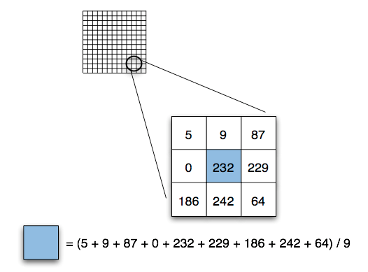
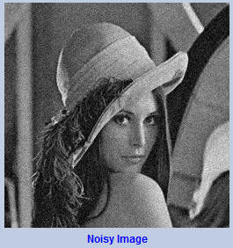
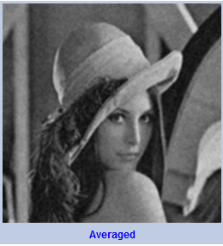
Image Processing (recap)
smoothing
Spatial operations
Mean filter.
117

Slide 6
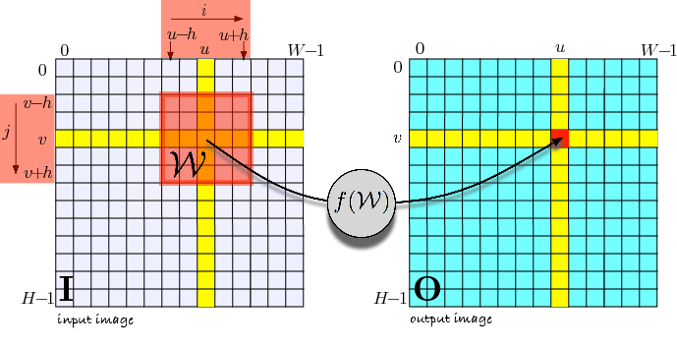
Image Processing
Computing the output pixel is also done with a convolution or a correlation kernel.
W a seperate kernel.

Slide 7
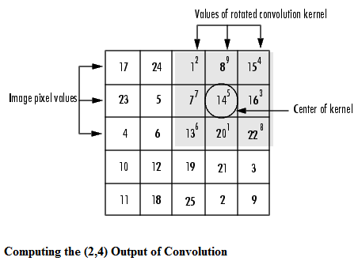
Convolution.
A neighborhood operation in which each output pixel is the weighted sum of neighboring input pixels. The matrix of weights is called the convolution kernel, also known as the filter.
The convolution kernel is a kernel that has been rotated 180 degrees
Rotate the convolution kernel 180 degrees about its center element.
Slide the center element of the convulotion kernel so that it lies on top of the (2,4) element of I. (matrix notation: row column)
Multiply each weight in the rotated convolution kernel by the pixel of I _{underneath.}
Sum the individual products from step 3.
180º
8
1
6
2
9
4
3
5
7
7
5
3
4
9
2
6
1
8
3x3 kernel
I

Slide 8
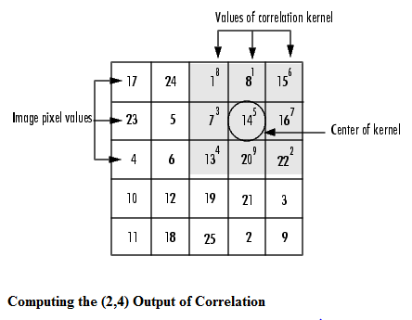
Correlation.
correlation is closely related to convolution. In correlation, the value of an output pixel is also computed as a weighted sum of neighboring pixels. The difference is that the matrix of weights, in this case called the correlation kernel, is not rotated during the computation.
8
1
6
Slide the center element of the correlation kernel so that lies on top of the (2,4) element of I. (matrix notation: row column)
Multiply each weight in the correlation kernel by the pixel of I _{underneath}
Sum the individual products from step 2.
3
5
7
4
9
2
3x3 kernel
I

Slide 9

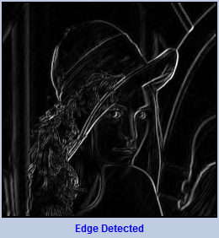
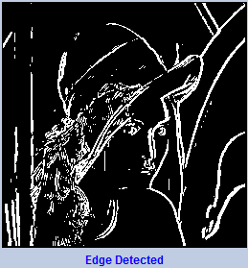
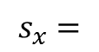
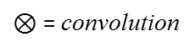


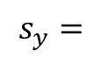
Image Processing
edge detection
A very important spatial operation
calling convolution*
-1
0
1
1
2
1
$$s_{x}=$$
-2
0
2
$$⊗Image$$
$$s_{y}=$$
0
0
0
$$⊗Image$$
-1
0
1
-1
-2
-1
Horizontal changes
Verticaal changes
$⊗$ = convolution

Slide 10
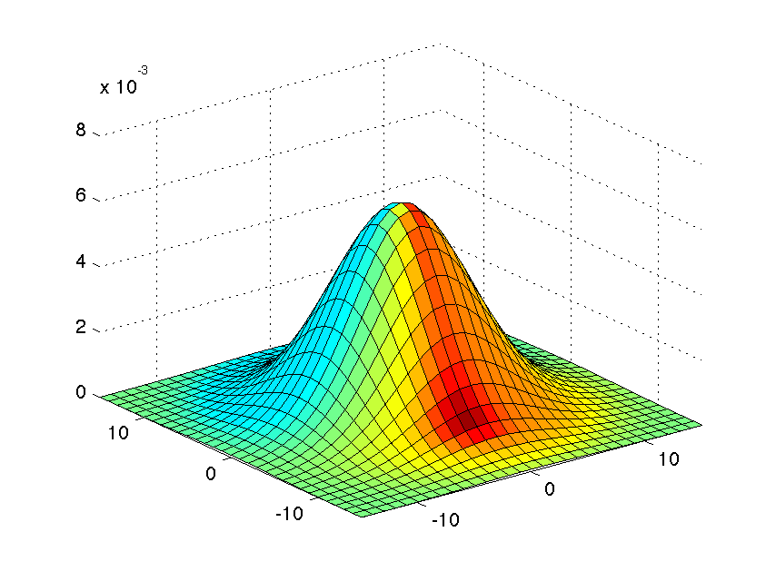
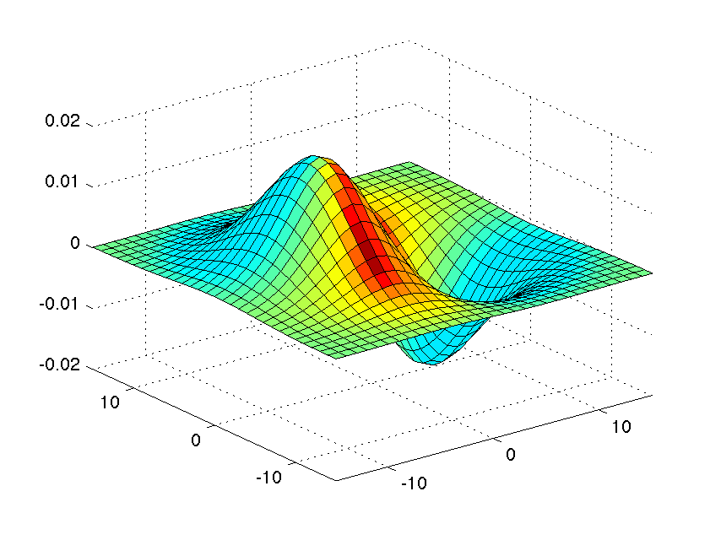

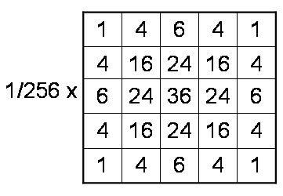
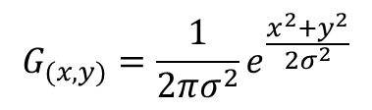
Image Processing
smoothing
How do we choose the mask weights?
Depends on the application
Usually by sampling certain functions and their derivatives
Derivative of Gaussian
1st 2nd deriviative
Gaussian
W
Good for image Smoothing
Good for image Sharpening
$$G_{(x,y)}=\frac{1}{2πσ^{2}}e^{\frac{x^{2}+y^{2}}{{2σ}^{2}}}$$
W

Slide 11










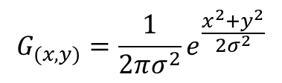
Image Processing
smoothing
= 1 pixel
= 5 pixels
= 10 pixels
= 30 pixels
$$G_{(x,y)}=\frac{1}{2πσ^{2}}e^{\frac{x^{2}+y^{2}}{{2σ}^{2}}}$$
The size of the mask controls the amount of smoothing

Slide 12
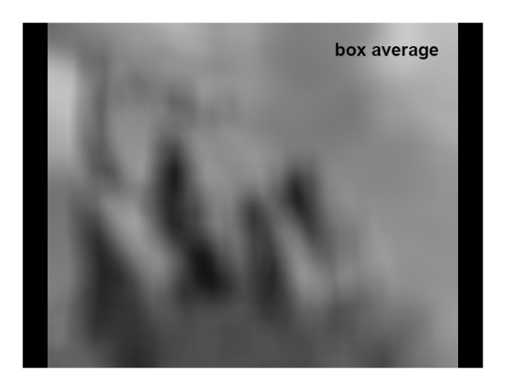
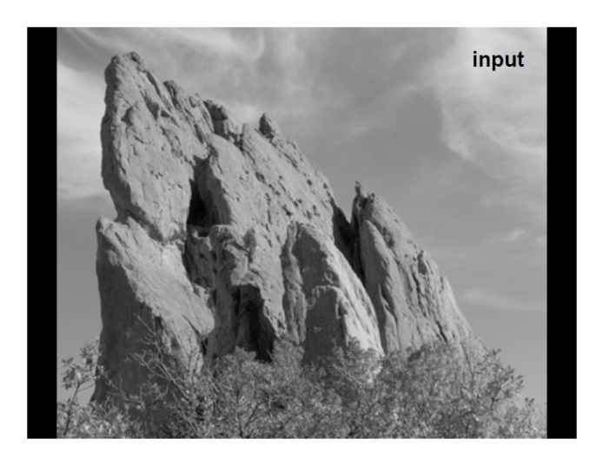
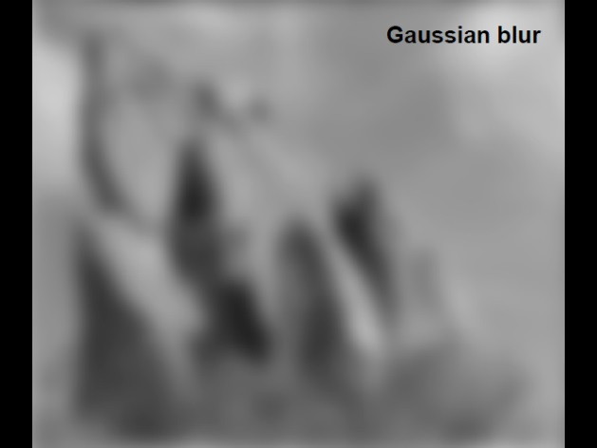
Image Processing
smoothing
Averaging vs Gaussian Smoothing
Click here for examples impemented in OpenCV

Slide 13
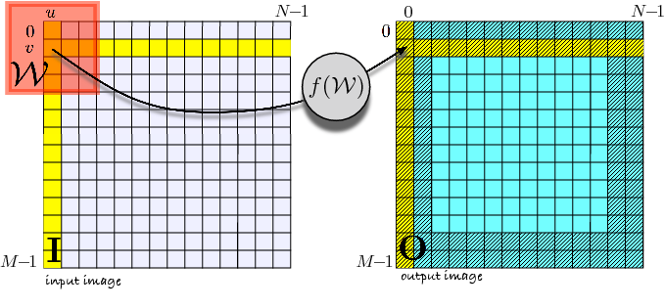
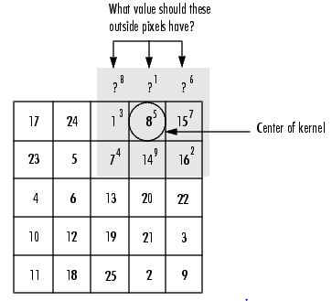
Image Processing
Boundaries
When computing an output pixel at the boundary of an image, a portion of the convolution or correlation kernel is usually off the edge of the image.
17
24
1
8
15
8
1
6
23
5
7
14
16
3
5
7
4
6
13
20
22
4
9
2
10
12
19
21
3
3x3 kernel
11
18
25
2
9
Input Image

Slide 14
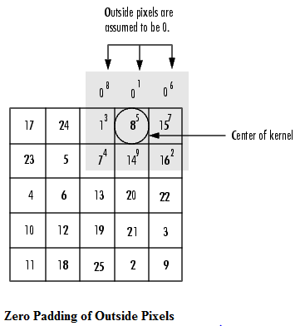
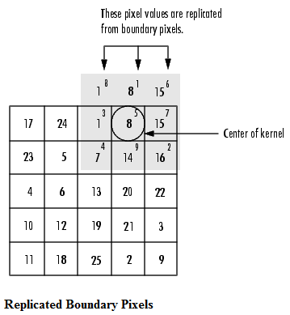
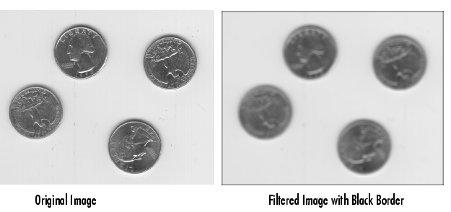
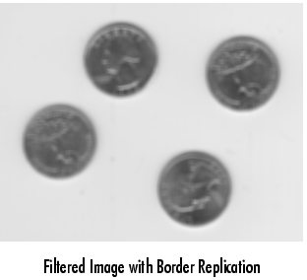
Image Processing
smoothing

Slide 15
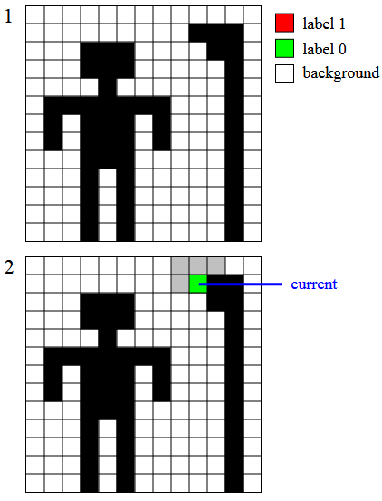
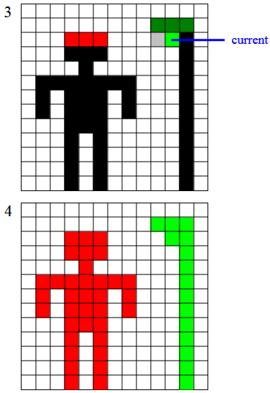
Image Processing
A simple but powerful tool for identifying and labeling the various objects in a binary
image is a process called region labeling, blob coloring, or connected component identification.
It is useful since once they are individually labeled, the objects can be separately
manipulated, displayed, or modified. For example, the term “blob coloring” refers
to the possibility of displaying each object with a different identifying color, once
labeled.

Slide 16
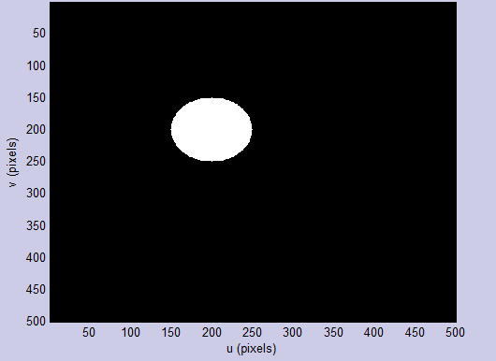
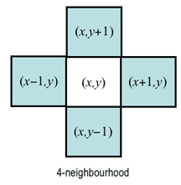
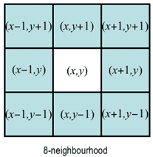
Image Processing
a blob is a region of a digital image in which some properties are constant or vary within a prescribed range of values; all the points in a blob can be considered in some sense to be similar to each other.
A region is a set of contiguous pixels of the same color ( value)
A pixel has the same labels as its N S E W neighbour
 | N
W |  | E
 | S
NW | N | NE
W |  | E
SW | S | SE

Slide 17
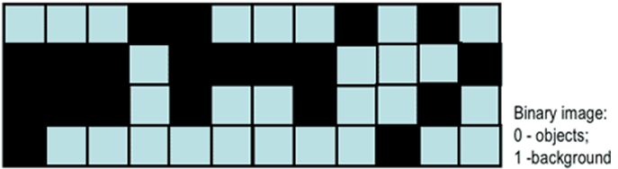
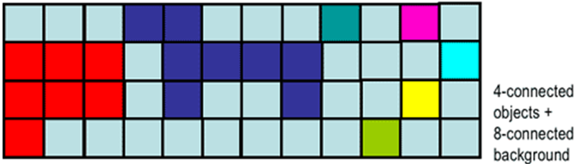
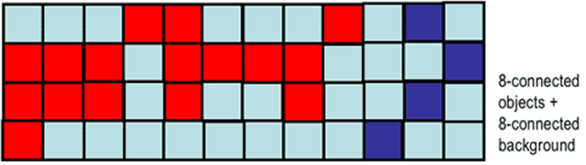
Image Processing
Region, connectivity

Slide 18

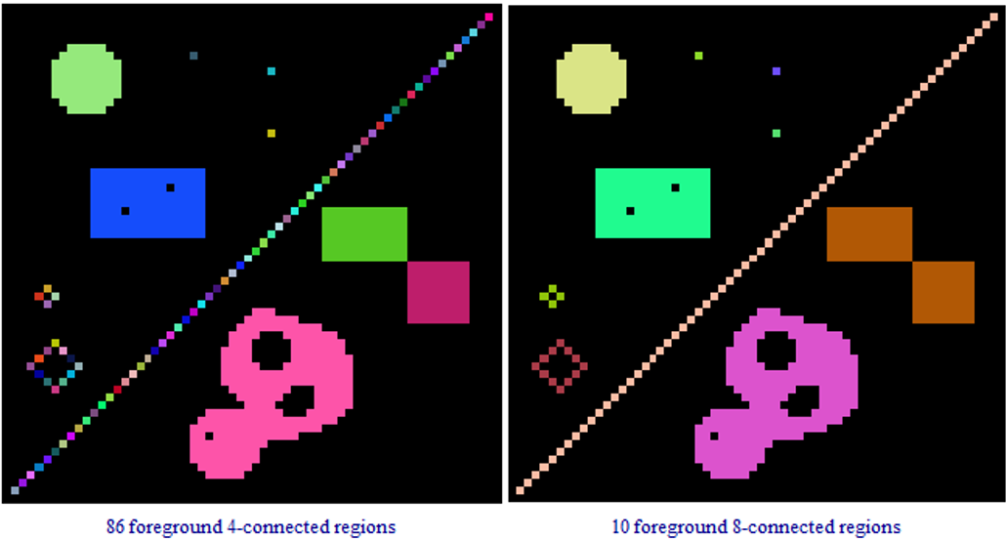
Connectivity, regions
In many practical cases, the connectivity is simply defined variously for objects (foreground pixels) and background.
E.g. 4-connectivity for objects and 8-connectivity for background or vice versa.
Does it make any difference: 4 or 8 connectivity ?

Slide 19
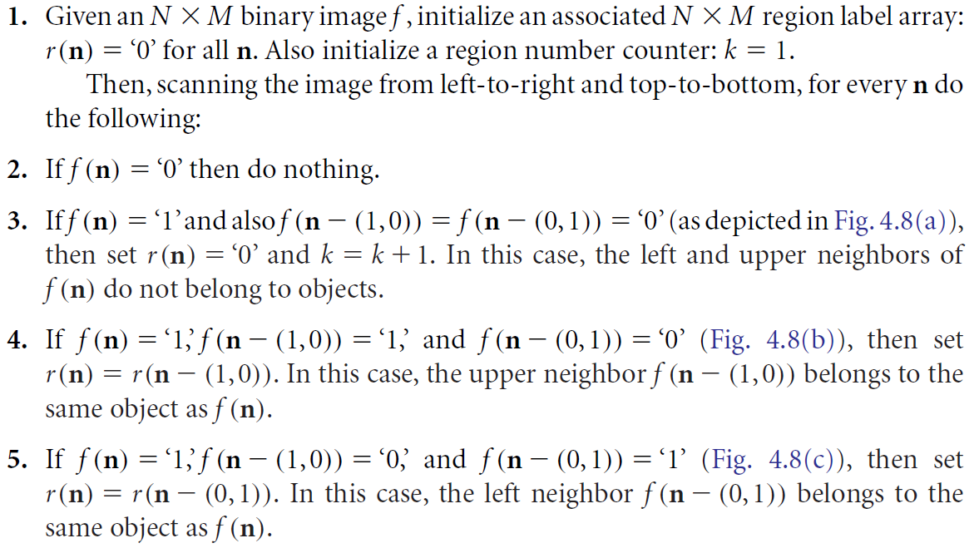
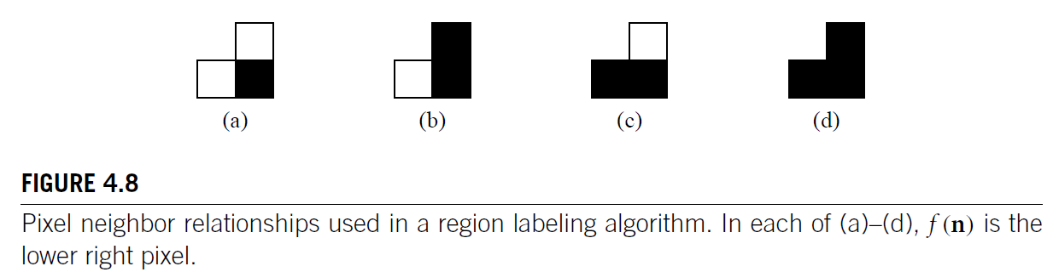
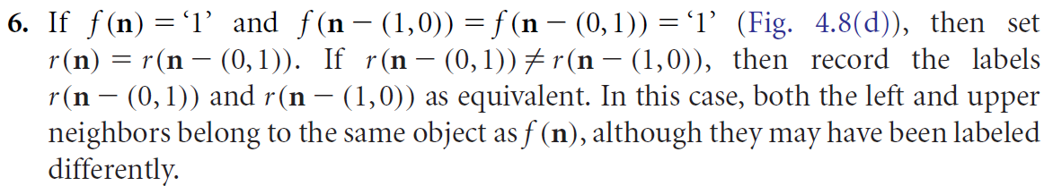
Region Labeling Algorithm
http://www.labbookpages.co.uk/software/imgProc/blobDetection.html

Slide 20
Image morphology
from the Greek word morphē, meaning shape or form
The foundation of morphological processing is in the mathematically rigorous field of set theory; however, this level of sophistication is seldom needed.
Most morphological algorithms are simple logic operations and very ad hoc. In other words, each application requires a custom solution developed by trial-and-error. This is usually more of an art than a science ☺
Operations
Dilation
Erosion
Open
Close

Slide 21
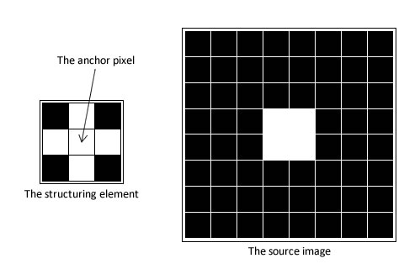
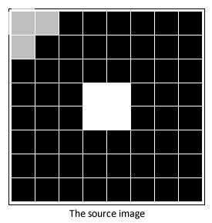
Image morphology
Dilation: adding pixels to the boundaries of original objects. The value of the output pixel is the maximum value of all the pixels in the input pixel’s neighborhood. In a binary image, if any of the pixels is set to the value 1, the output pixel is set to 1.
Note: Kernel is cross shaped CV_SHAPE_CROSS
Making Your Own Kernel is possible!

Slide 22
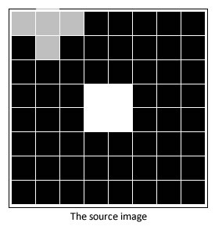
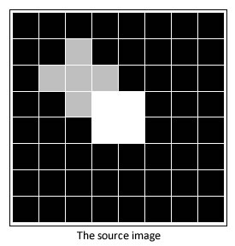
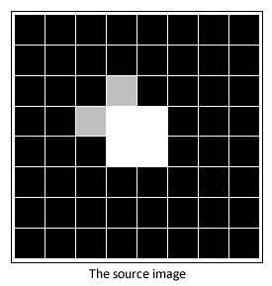
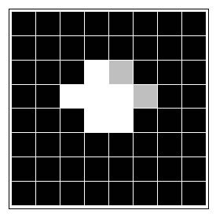
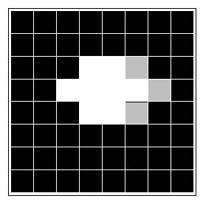
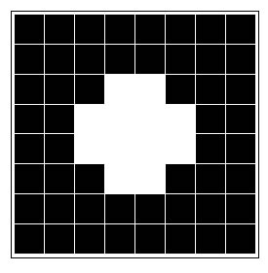
Dilation sequence:

Slide 23
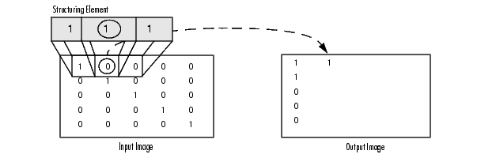

Morphological Dilation of a Binary Image
Morphological Dilation of a Grayscale Image, See also SharePoint for more information

Slide 24



Image morphology
Erosion: removing pixels on object boundaries. The value of the output pixel is the minimum value of all the pixels in the input pixel’s neighborhood. In a binary image, if any of the pixels is set to 0, the output pixel is set to 0.

Slide 25






Erosion Sequence:

Slide 26

Erosion is NOT the inverse of Dilation

Slide 27

Image morphology
Open: erosion followed by dilation. It can remove tiny white lines or spots with black regions
Close: dilation followed by erosion. It can remove tiny black lines or spots with white regions

Slide 28

Image morphology
examples

Slide 29

Image morphology
examples

Slide 30
End of week 2.
Questions ?
Assignments: MINES-VIS2015 week 2 Assignments.pdf
See this link for more detailed information about Image Filtering with OpenCV

Slide 31
Set theory, basic concepts
If every element of set A is also an element of another set B, then A is a
subset of B and we write A ⊆ B
• The union of two sets A and B, denoted by C = A ∪ B, is the set of all
elements belonging to either A, B, or both
• The intersection of two sets A and B, denoted by D = A ∩ B, is the set of
all elements belonging to both A and B
• Two sets are disjoint or mutually exclusive if they have no elements in
common
A ∩ B = ∅
• The complement of a set A is the set of elements not in A
Ac = {w | w ∉ A}
• The difference of two sets A and B, denoted A-B, is defined as
A-B = {w | w ∈ A, w ∉ B} = A ∩ Bc

Slide 32




Arithmetic operation between images
Arithmetic operations are performed between the corresponding pixel pairs in f and g
$$s\left(x,y\right)=f\left(x,y\right)+g(x,y)$$
$$d\left(x,y\right)=f\left(x,y\right)−g(x,y)$$
$$p\left(x,y\right)=f\left(x,y\right)×g(x,y)$$
Example:
$$v\left(x,y\right)=f\left(x,y\right)÷g(x,y)$$

Slide 33

Arithmetic operation between images
Example:

Slide 34
Set and Logical Operations
Set operations:

Slide 35
Set operation, an example.

Slide 36
Set and Logical Operations
Logical operations:

Slide 37

Set and Logical Operations
Example logical OR operator

